Slide 2
PROUDLY PRESENTS

Slide 4
Background
Usually 2 or 3 babies receive phototherapy care daily.
Newborns get phototherapy care while they are with mothers. Since our hospital is named as A baby friendly hospital , we try to keep the baby with mother as far as possible.
We have to keep the baby at the one edge of the bed closed the mother for receiving optimal phototherapy.
There were 3 adverse incidents reported to the QMU of Ragama from the Obstetric ward of the prof.Unit ,(ward25) of falls of neonates from the mothers beds while receiving phototherapy.
Even the number of falls during (date and time attached) was fairly low comparing the no. of neonates who got phototherapy daily, impact to mothers mentality is very high and babies are at risk of injuries.
Fortunately no injury to the babies was reported
Reasons for fall of babies
1-most mothers were fallen asleep due to exhaustion and fatigability following child birth.
2-babies are kept at the one edge of the bed
3-Restriction of the bystanders due to prevailing covid situation
QMU discussed the matter and requested them to make a solution by their own.

Slide 5
Incidents of falls of babies ward 25 CNTH Ragama
INDEX | BHT | AGE | DATE AND TIME
1 | 43155/19 | D3 | 5.45 am 17/4/2019
2 | 111942/19 | D5 | 3.45 am 29/9/2019
3 | 193884/19 | D8 | 8.55 pm 10/12/2019
4 | 7508/20 | D1 | 1.45 am 7/3/2020
5 | 26572/20 | D7 | 1 pm 2/7/2020
6 | 88095/20 | D5 | 2.30 am 12/9/2020
7 | 35689/21 | D4 | 12.05 pm 22/4/2021

Slide 6
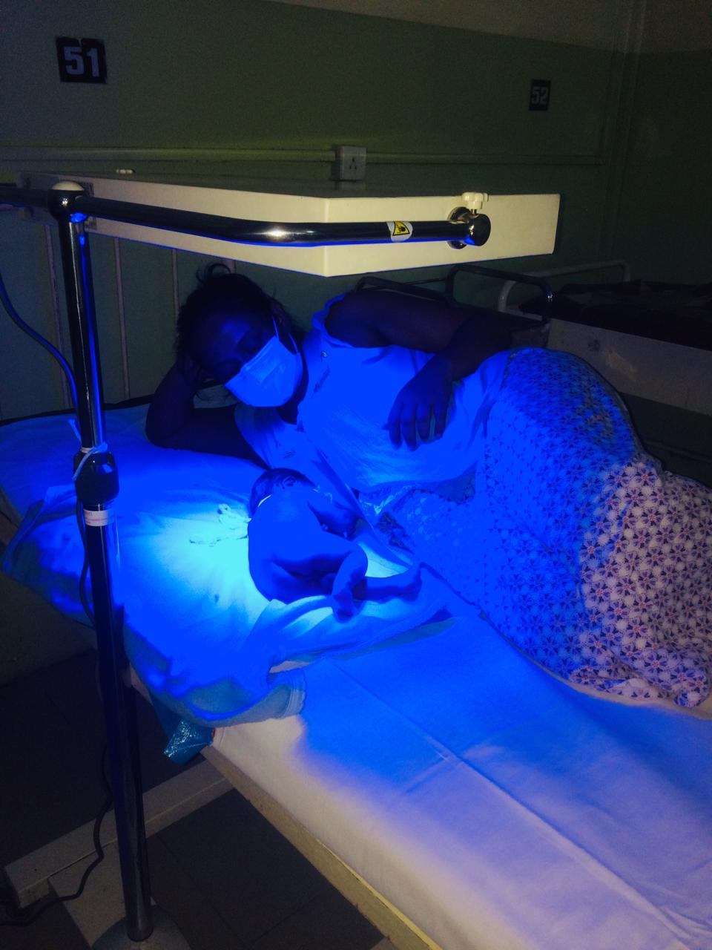
Tendency to fall of neonates from the mothers beds while receiving phototherapy

Slide 7
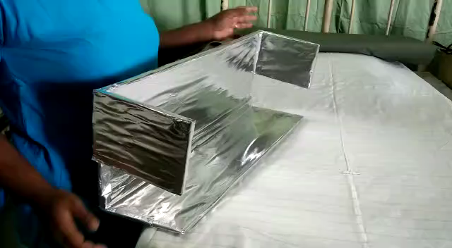
INNOVATION
As a result of existing system of incident reporting we were able to identify the problem & innovate this device.
A baby safety guard to prevent babies been fallen from the bed while taking phototherapy and optimize the process.

Slide 8
Indication for photo therapy:-Treatment with phototherapy is implemented in order to prevent the neurotoxic effects of high serum unconjugated bilirubin. Phototherapy is a safe, effective method for decreasing or preventing the rise of serum unconjugated bilirubin levels and reduces the need for exchange transfusion in neonates.

Slide 9
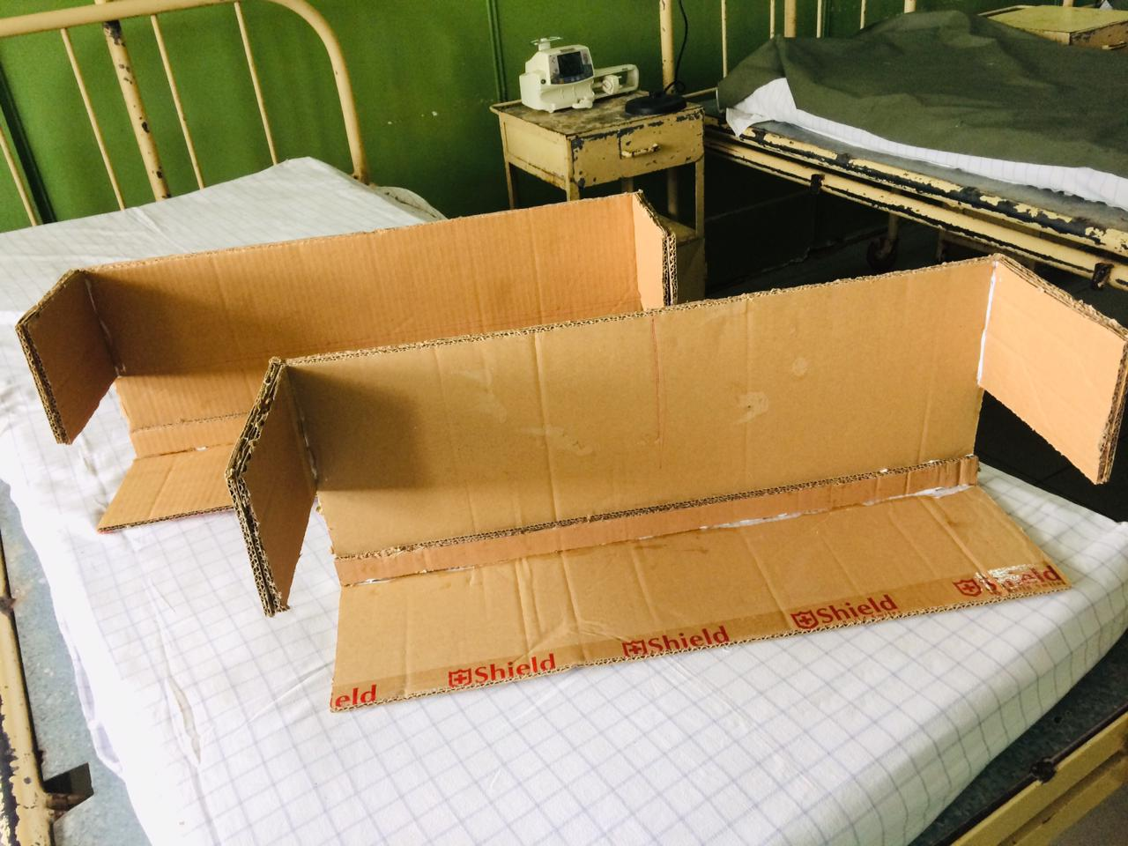
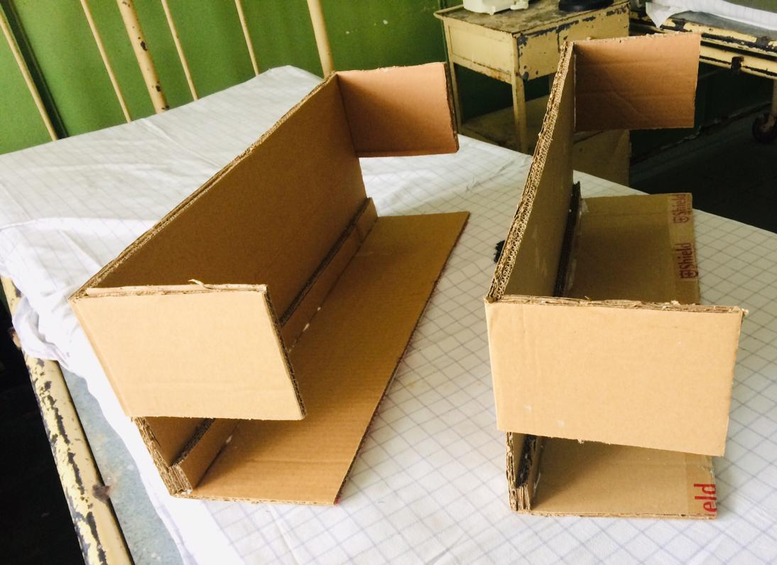
How is it made? The team of ward 25 Prof. unit had a two three rounds of discussions and finally made it possible.

Slide 10
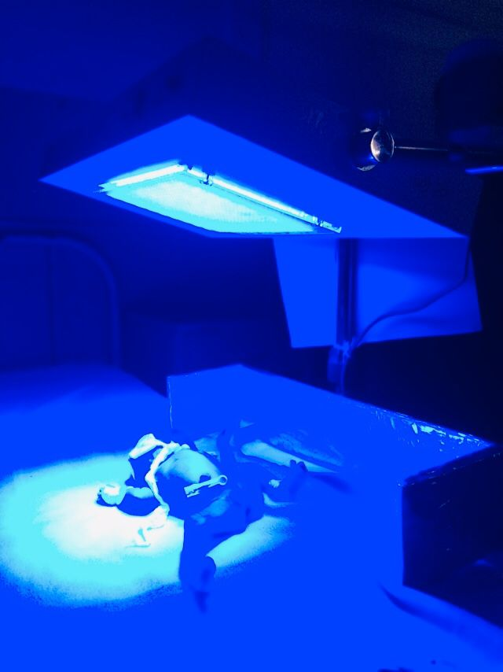
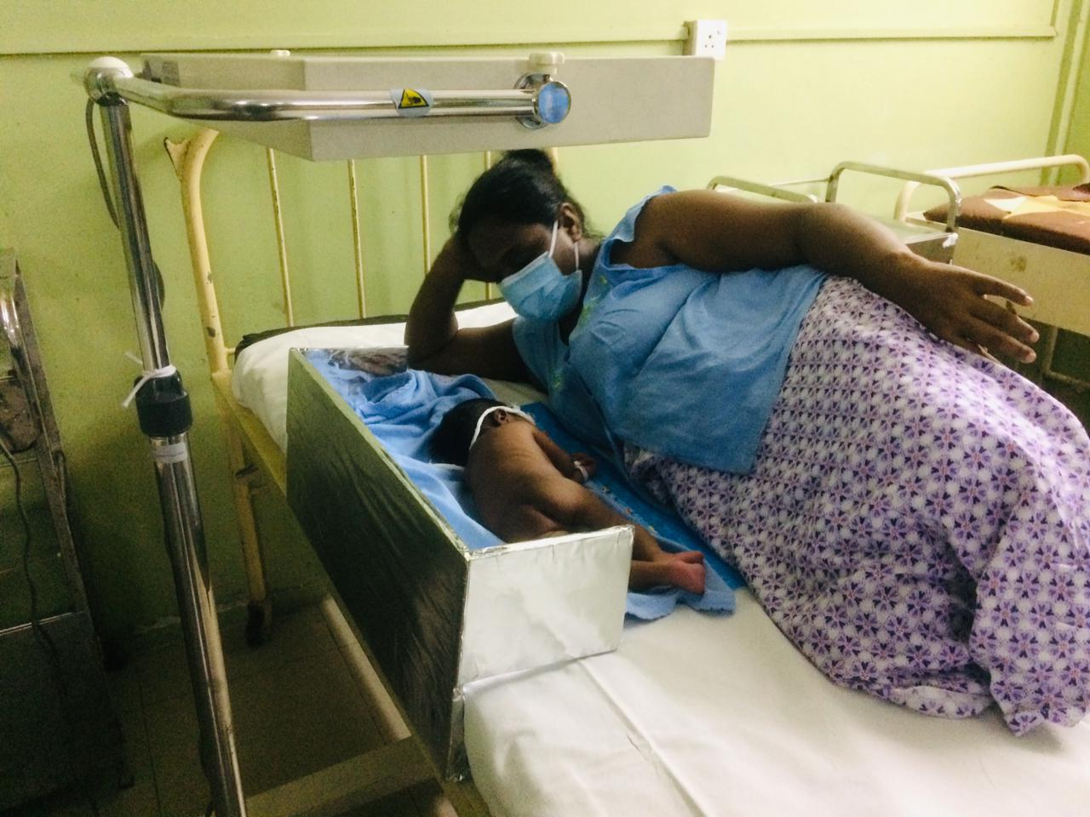
How is this device applied?
attached or fixed underneath the mattress. But it is removable. [ Date of Commencement – 20th June 2021]

Slide 11
Why is this effective?
Safe for the child.
Light weighted(<500g)
Low cost(cost for alluminium foil/binder gum Rs.100)
Easy to handle and clean.
Equally and Effectively cover phototherapy.
No need of specialized training to make it.
Enviornment Friendly

Slide 12
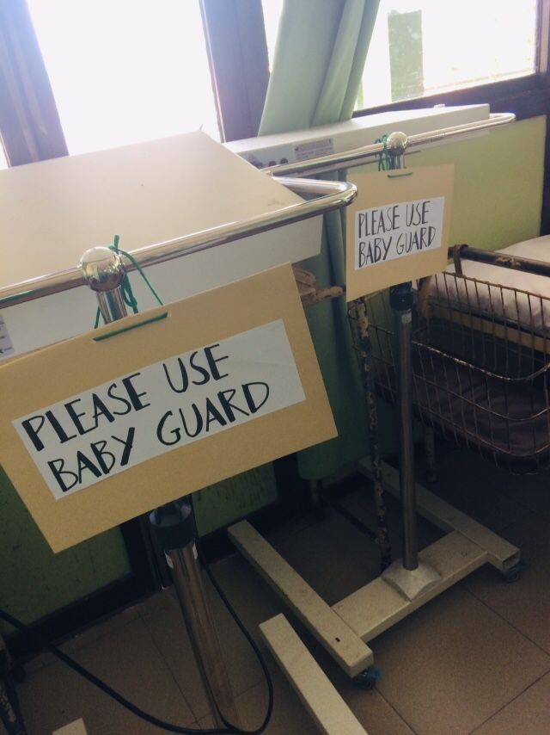
Any measures for sustainbility?
Notify all the staff by using a video clip [ Demonstration ]
Staff training.
Hanging notices on phototherapy machine. [Reminders.]

Slide 13
Is it effective?
No more falling indent is reported after introduction of this device
Reflection of blue light from the device may enhance the
Effectiveness of therapy(we have to assess.we have a plan of retrospective study of length of stay of babies)
Is there an expected improvement?
If it can be made of light weighted wood ,quality of the product will be improved and it can be used for a longer time.

Slide 15
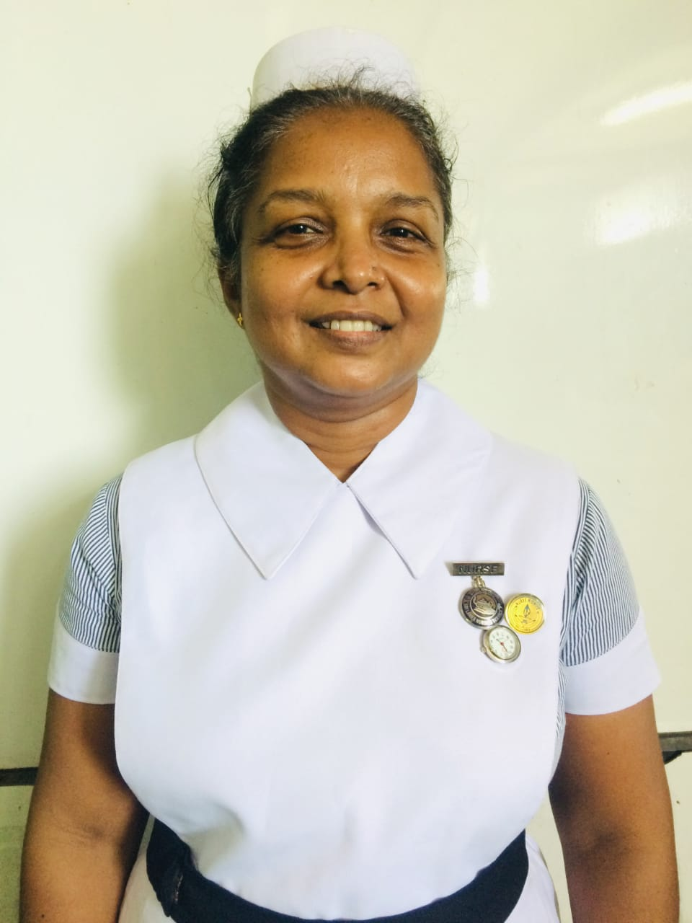
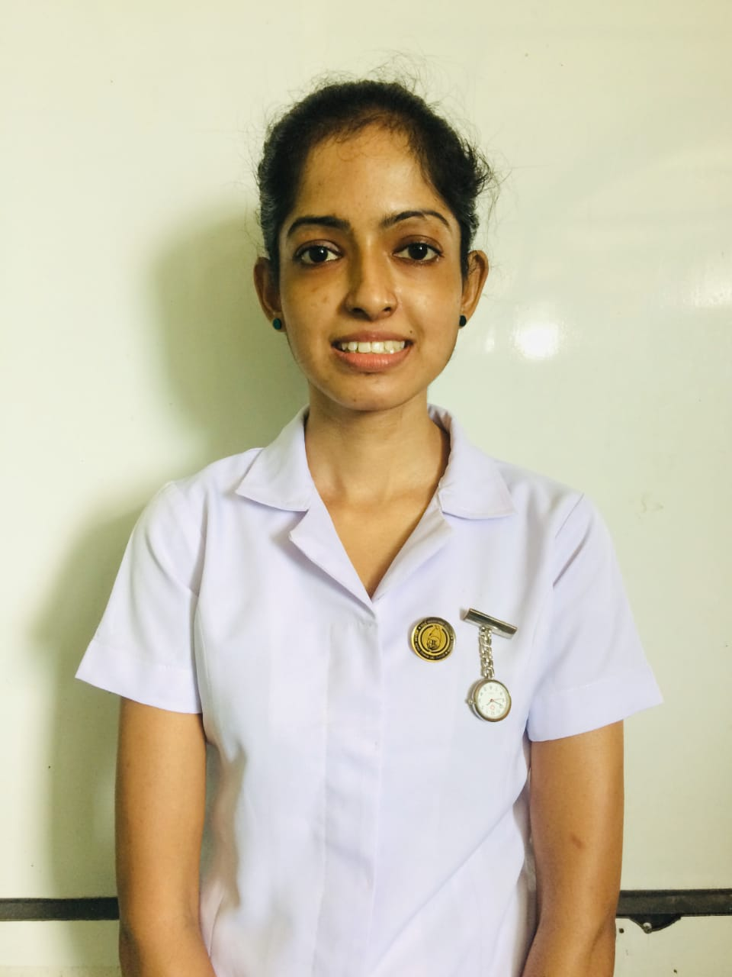
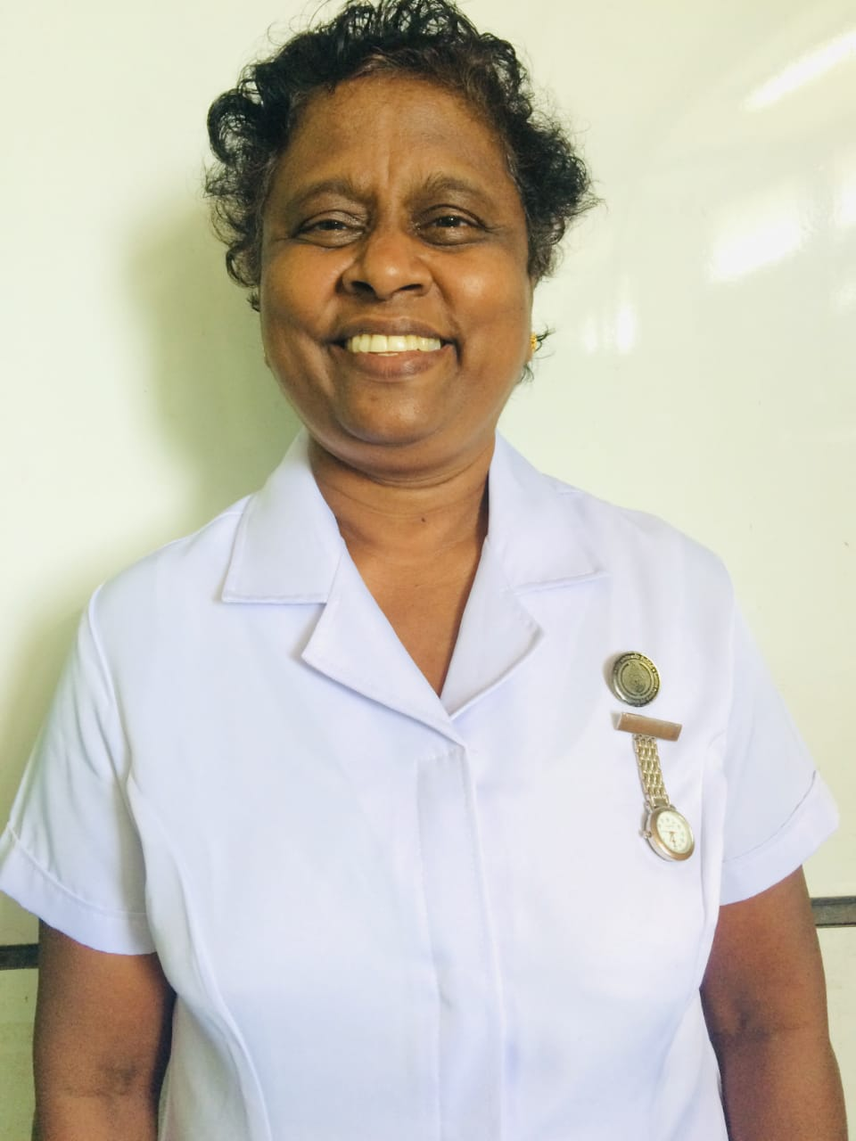
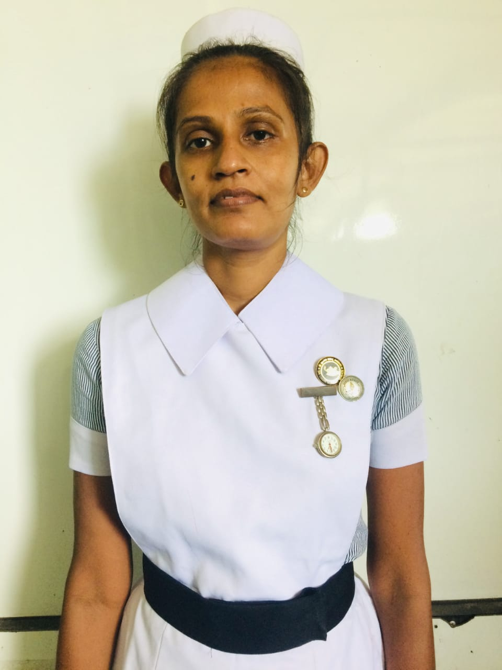
All credits go to the team ‘25
N/O-Mrs.M.K.A.N.Alwis
Team Leader
F/H MW-Mrs.B.A.A.L.Balasooriya
F/H MW-Mrs.M.L.J.Rubasinghe
N/O-Mrs.W.W.A.T. Weerasighe

Slide 16
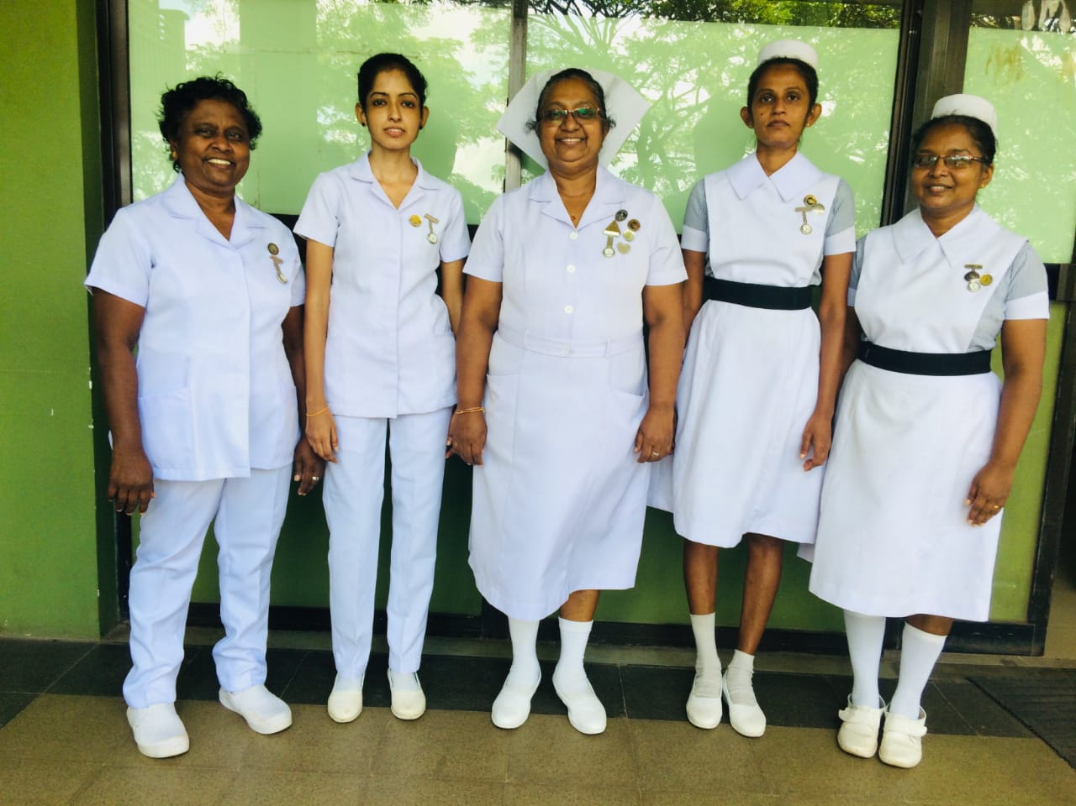

Slide 17
Thank you!

